Slide 1
Goals, Decisions and the Pursuit of Happiness
HS62002 Science of Happiness and Well-being
Autumn 2018

Slide 2
Outline
Safety Share
Review – Relaxation and Focus Training
Goals, Decisions and the Pursuit of Happiness

Slide 3
Safety Share

Slide 4
Review – Relaxation and Focus Training

Slide 5

Goals
What is a goal?
the object of a person's ambition or effort;
an aim or desired result
If you want a happy life, tie it to a goal, not to people or things – Albert Einstein

Slide 6
Goals
Short term goals
A short term goal is any goal that you set for yourself that can be accomplished within 12 months, and may even be accomplished the day you set that goal.
Career, Personal Development, Financial, Fitness
Long term goals
To sleep peacefully and happily after each day's job till the day I die
Great leaders don't set out to be a leader...they set out to make a difference.
It's never about the role and always about the goal.

Slide 7

Patience and Goals
Any great goal cannot be achieved without patience and persistence.
If we truly want something, we need to do the tough thing instead of the fun thing and probably we will have to delay gratification.

Slide 8
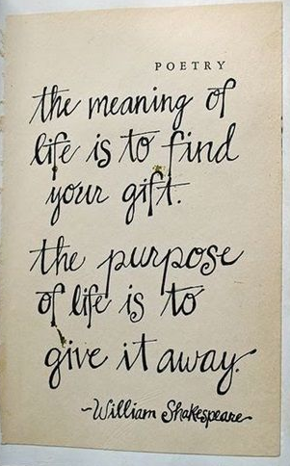
Real Goals
Why am I here?
What am I to do?
Where am I going?

Slide 9



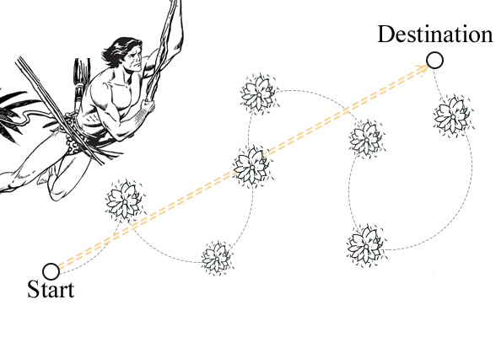
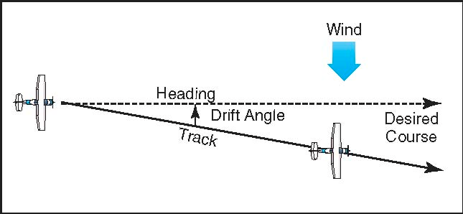
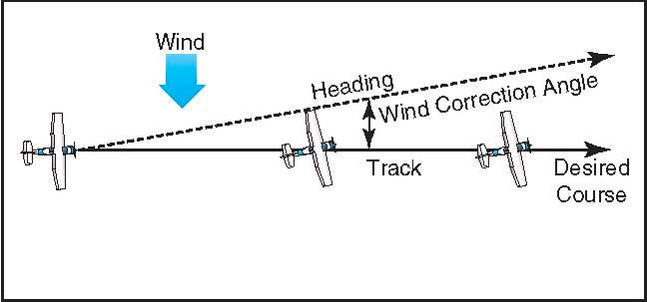
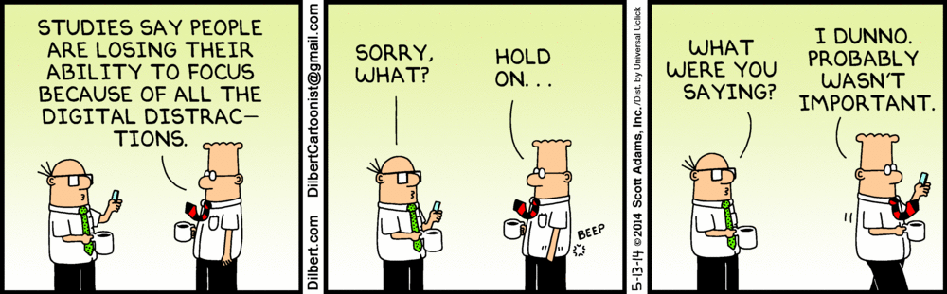
Survival
Getting to the goal
Distractions
Deviation
Delay in getting to the goal causes unhappiness

Slide 10



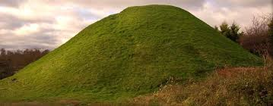
After the goal is achieved?
A goal is not always meant to be reached, it often serves simply as something to aim at.”
New definitions

Slide 11
Looking for Strength
One man decided to reach for his dream. But he didn’t have enough strength to do it.
So he turned to his mother :– Darling, I would be glad to help you, but I don’t have it. And everything I have, I already gave to you…
He asked a wise man:– It is said that, it is on the Everest. But I couldn’t find anything there, except the snowy winds. And when I came back, the time was irretrievably lost…
He asked the hermit:– In your prayers, my son. And if your dream is false, you will understand it and find peace in your prayers…
The person asked everyone, but the only result of his searches was confusion.
– Why are you so confused? – asked an old man passing by. – I have a dream, good man. But I don’t know where to find strength for its realization. I asked everyone, but there was no one who could help me.
– No one? – a light flashed in the old man’s eyes, – And did you ask yourself?

Slide 12

Decisions
Types
Good, Right, Best - https://youtu.be/p54xa77U7is
Mind and Heart
What choice is going to take me toward my vision and is most aligned with my values?
Under the time pressure condition, the students were far more likely to make risky decisions when they were feeling happy—and far less likely to make risky decisions when they were primed to feel sad.
Material and Spiritual
Natural Selection
Destiny?

Slide 13
Considering a decision
Stay Calm
Get as much information as possible
The five “Whys?” technique
Who is affected?
List all the options
Pros and cons
Let the space between thoughts to arise
Distinguish between an impulse and intelligent decision

Slide 14
How can I be sure with my decisions?
You can't. Nobody can be sure one hundred percent every time -- that's just life. A good rule of thumb is to live like as if you're dying (seize every opportunity that is good) but plan as if you'll see tomorrow (doing so with caution).

Slide 15
Am I making the best decision?
You never usually know if you're making a good decision, but it could help to write down the good and bad things about you're decision. Also, try not to think of bad decisions as failure; think of them as a learning experience.

Slide 16
Results of Decision
Acceptance
Tolerance
Correction
Happiness in decision making

Slide 17
Stop regretting decisions
Stop looking to the past, look to the present and future.
Embrace and own the decisions you have made and move on.
Other than learning from past decisions, no good can come from reliving mistakes over and over again.

Slide 18
Pursuit of Happiness
Pleasure and happiness
Taking and Giving

